Slide 1
Normalization

Slide 2
Why we use normalization
Reduce data redundancy
No loss of information
Save database space
So let’s see some more detail

Slide 3
Types of Normalization
6 types of normalization but basically use 3 forms
1st NF- remove repeating groups of data
2nd NF-remove partial dependency
3rd NF-remove transitive dependency

Slide 4
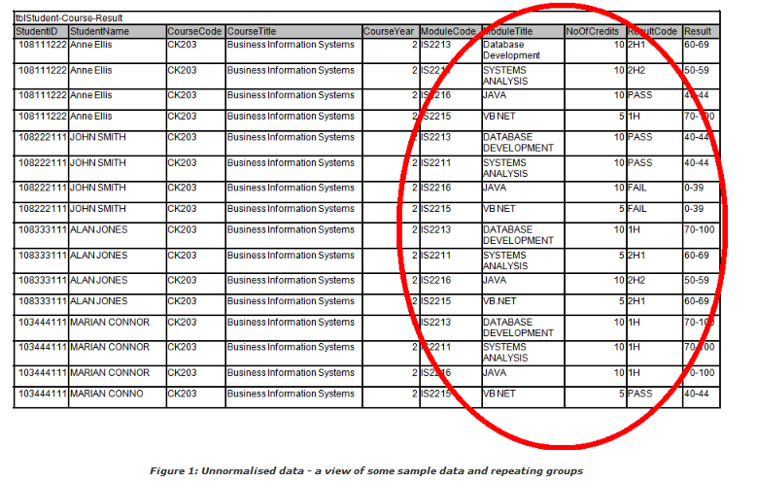
Look up the table

Slide 5
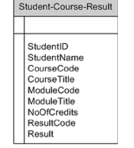
Unnormalised Data
StudentID is the primary key

Slide 6
1st NF
Steps to reduce the repeating groups of data:
Pick a value for the repeating data
To uniquely identifies each line within the document
We have chosen the Modulecode

Slide 7
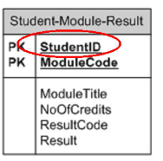
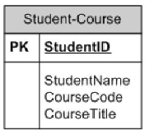
1st NF
MoudeCode is the primary key for the repeating data
1st table split into two tables and reduce the repeating data

Slide 8
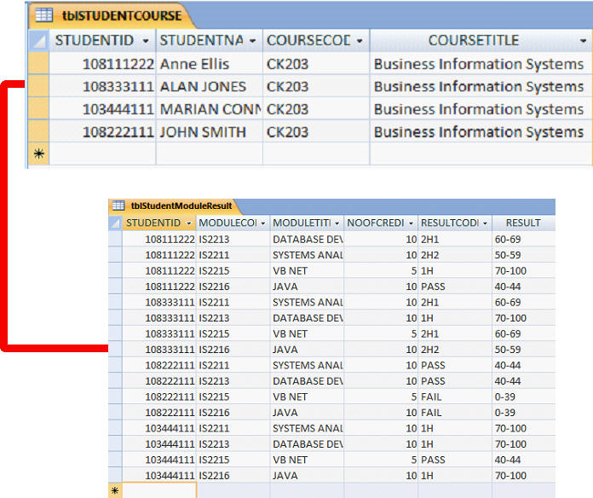
Relation between two tables

Slide 9
2nd NF
Steps of 2nd NF
You only check for Partial Dependencies
if you have an entity (table) which has a composite key (multi-attribute primary key)

Slide 10
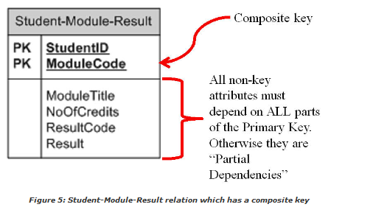
Partial dependencies

Slide 11
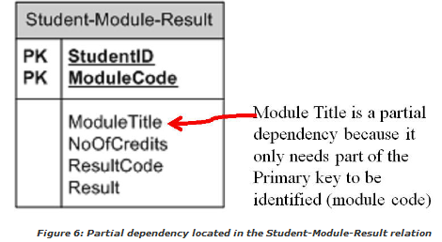
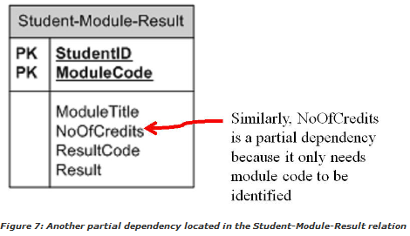

Slide 12
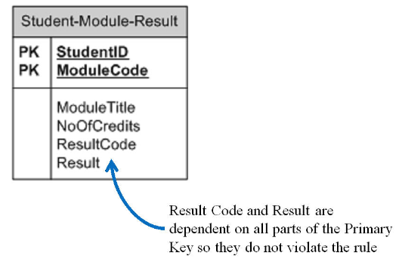

Slide 13
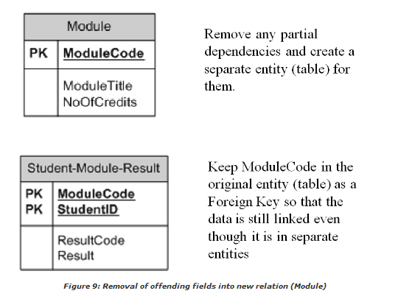
Remove partial dependencies

Slide 14
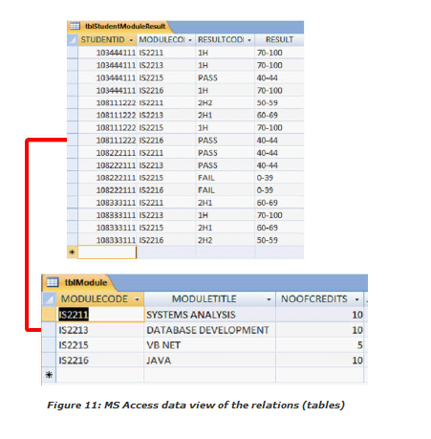
relationship

Slide 15
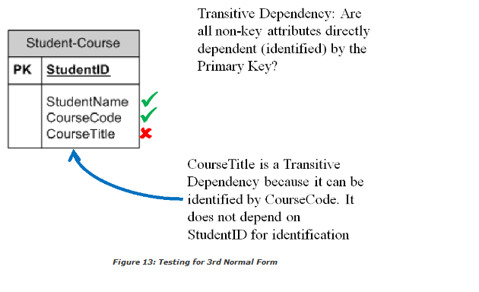
3rd NF

Slide 16
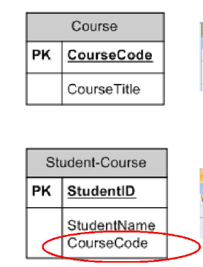
Transitive dependency
Coursecode is the PK with course title attributes
It has a foreign key relation with Student-course table

Slide 17
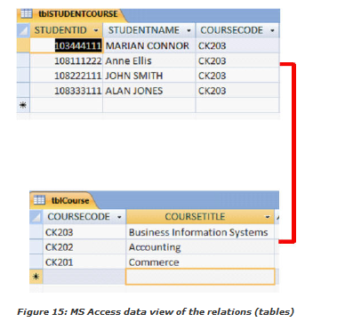
Relationship

Slide 18
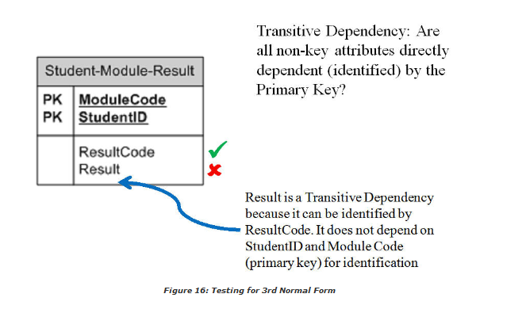

Slide 19
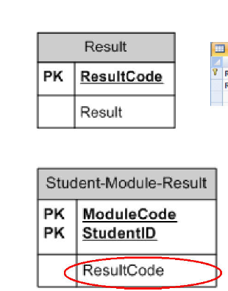
Reseult has transitive depencency on result code and seperated by PK that is Resultcode
Resultcode is called in the Student-module-result table as the foreign key

Slide 20
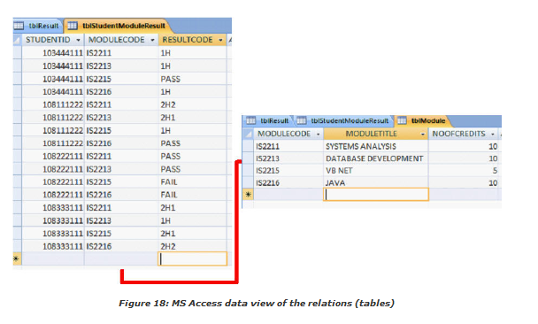
Relations

Slide 21
Breaking main table into small tables

Slide 22
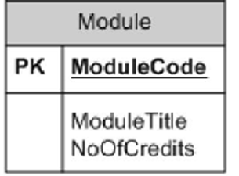



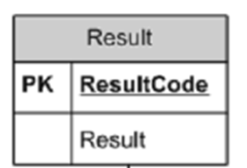
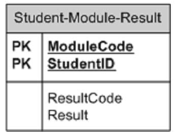




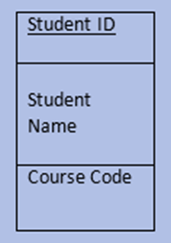
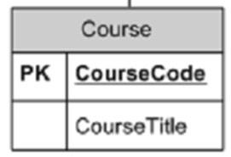

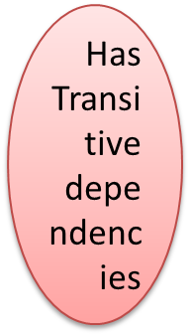
2 PK
No Transitive dependency
Has Transitive dependencies
Student-Module-result
Module Code Student ID
Result Code
One PK
1st NF
2nd NF
Remove partial dependency
Remove repeating groups of data
3rd NF
Remove transitive dependency

Slide 23
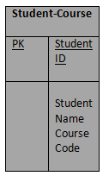
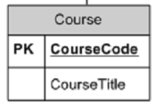

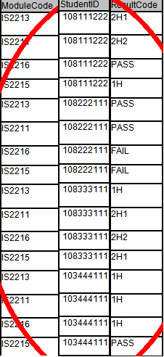

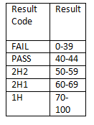
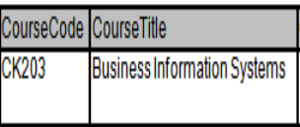
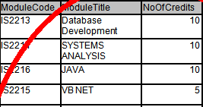


Student-Module-result
Module Code Student ID
Result Code

